Slide 1
Gym Management System: A C++ Implementation
This presentation outlines the design and implementation of a Gym Management System developed in C++. This project demonstrates fundamental data structures and algorithms, offering a robust solution for managing gym members, their registrations, and payment details. It emphasizes efficiency and maintainability in a real-world application context.
Submitted To: Shakeel Ahmad
Students By:
M. Sohaib Kamran (4784-FOC/BSSE/F23)
Soban Abbass (4805-FOC/BSSE/F23)
M. Huzaifa (4801-FOC/BSSE/F23)
M. Zayd Dawood (4818-FOC/BSSE/F23)

Slide 2
Project Overview and Objectives
Project Scope
Core Objectives
The Gym Management System is designed to streamline administrative tasks for gym facilities. It focuses on core functionalities essential for daily operations, including member registration, detailed record keeping, and financial transaction tracking. The system aims to enhance efficiency and reduce manual processing errors.
Efficient member data handling.
Secure payment record management.
Facilitate quick data retrieval and sorting.
Provide a user-friendly interface for gym staff.
Demonstrate practical application of C++.

Slide 3

System Architecture: Data Structures
Registration Struct
Payment Struct
Membership_type Struct
Captures comprehensive member details: name, job title, email, address, CNIC number, and cell number.
Records financial data: payment method, amount, and a secure PIN for card transactions.
Defines the type of membership plan (e.g., Gold, Platinum, Bronze) chosen by the member.
Designed to store essential personal and contact information for each gym member.
Ensures all transaction details are accurately stored and linked to the respective member.
Allows for flexible membership offerings and easy categorization of members.
The system leverages C++ structs to organize and manage member data effectively. These structures are integral to maintaining a clear and accessible database for all gym operations.

Slide 4
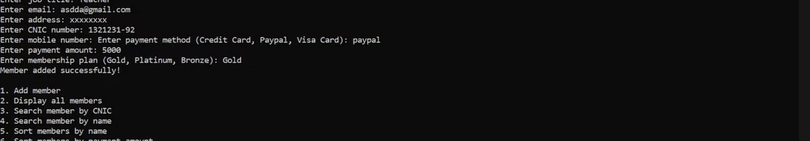


Key Functionalities: Adding and Displaying Members
Add Member
Gathers new member's personal, contact, payment, and membership plan details. Incorporates input validation for data integrity.
Display Members
Iterates through the stored member array and presents all registered members' information in a clear, formatted output, including payment and membership details.
The primary functions of the system include adding new members and displaying all existing member records. These functions are critical for initial data entry and for reviewing the complete member database.

Slide 5



Searching Capabilities
Search by CNIC
This function efficiently locates a member's record by their unique CNIC number, ensuring quick access to specific profiles. It iterates through the member array, comparing the provided CNIC with stored values.
Search by Name
Allows staff to find members by their full name, providing flexibility when the CNIC is not readily available. This search is case-sensitive and performs a linear scan through the database.
Two distinct search functions are implemented to provide flexible and efficient member retrieval. These search mechanisms are crucial for administrative tasks such as updating records or addressing member inquiries swiftly.

Slide 6
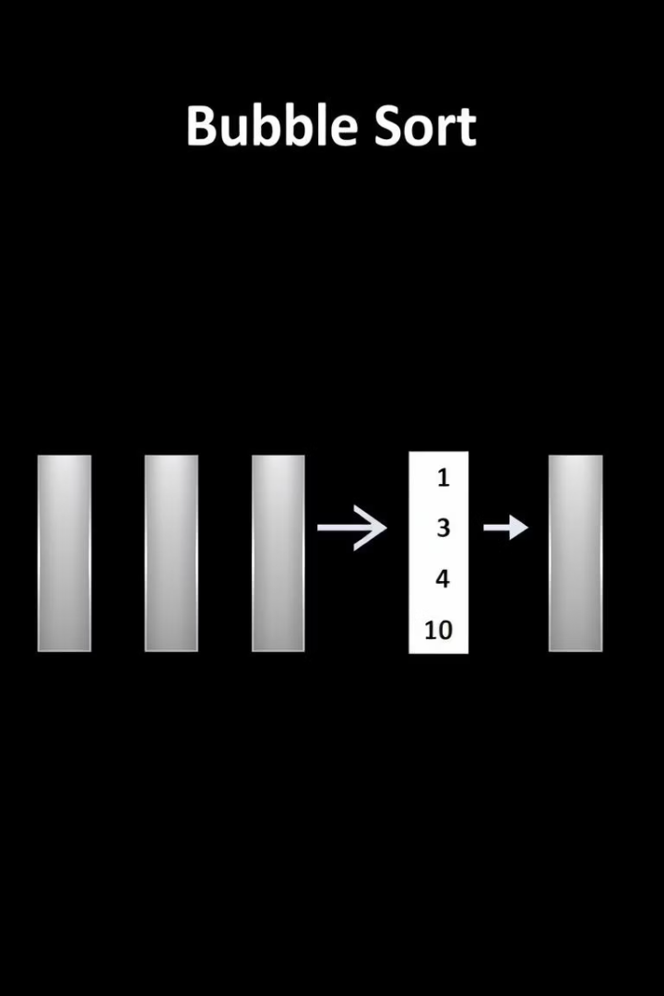


Sorting Algorithms for Data Management
Sort by Name
Employs a Bubble Sort algorithm to arrange member records alphabetically by name. This ensures that member lists can be quickly organized for easier browsing and reporting.
Sort by Payment Amount
Utilizes Bubble Sort to order members based on their payment amount. This is useful for financial analysis, identifying high-value members, or tracking payment trends.
To enhance data utility and administrative efficiency, the system incorporates sorting functionalities. These features allow gym staff to quickly organize member information based on different criteria, facilitating various management tasks.

Slide 7
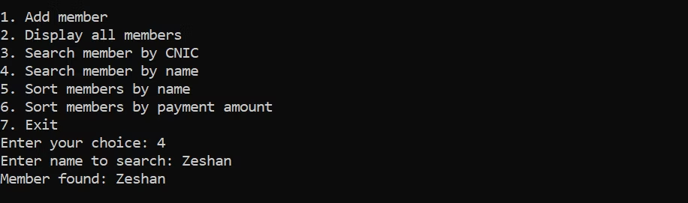
User Interface and Interaction Flow
Loop for Continuity
Function Execution
The menu continuously loops until the user explicitly chooses to exit, ensuring persistent system availability.
Choice Input
Based on the choice, the relevant function (e.g., add_member(), display_members()) is called, performing the requested operation.
Main Menu Display
Prompts the user to enter their choice, which is then processed by a switch statement to direct to the appropriate function.
Presents a clear, numbered list of options to the user, including adding, displaying, searching, and sorting members, along with an exit option.
The system features a console-based user interface, designed for simplicity and ease of use. It guides the user through a menu-driven interaction, allowing them to perform various operations seamlessly.

Slide 8

Implementation Details: C++ Specifics
Global Constants
MAX_MEMBERS defined for array sizing, providing a fixed capacity for member storage.
Namespace
Standard namespace used to simplify code by avoiding std:: prefix.
Input Handling
Uses cin.ignore() with getline() for robust string input after numerical inputs, preventing buffer issues.
Data Persistence
In-memory arrays for storing member data; data is volatile and resets on program termination.
The project is entirely implemented in C++, leveraging core language features for its functionality. Key programming practices are followed to ensure a stable and functional application, demonstrating foundational software engineering concepts.

Slide 9








Future Enhancements and Scalability
Database Integration
Advanced Features
Transition from in-memory arrays to a persistent database (e.g., SQLite, MySQL) for data storage, ensuring data integrity and durability across sessions.
Implement features like attendance tracking, class scheduling, trainer assignment, and automated billing to enhance system utility.
Graphical User Interface (GUI)
Security Measures
Develop a user-friendly GUI using frameworks like Qt or GTK+ for a more intuitive and visually appealing user experience.
Enhance security with encryption for sensitive data (e.g., payment PINs) and user authentication for staff access.
While the current system provides a solid foundation, several potential enhancements can significantly improve its functionality and usability. These upgrades would transform it into a more comprehensive and robust gym management solution.

Slide 10
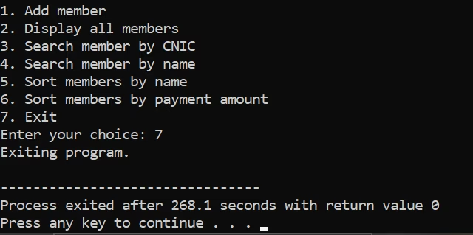



Conclusion and Key Takeaways
Practical Application
1
Demonstrated the practical application of C++ in building a functional management system.
2
Core Concepts
Reinforced understanding of data structures (structs, arrays) and algorithms (searching, sorting).
3
Problem-Solving
Addressed real-world challenges in data management and user interaction.
This project successfully delivered a foundational Gym Management System using C++. It highlights the importance of well-structured code, efficient algorithms, and thoughtful user interaction design in software development. The experience gained is invaluable for future projects in software engineering.

